Slide 1


Intensifying expletive constructions in English tweets: the case of #wokeAF
Andreea S. Calude, Amber Anderson, David Trye

Slide 2
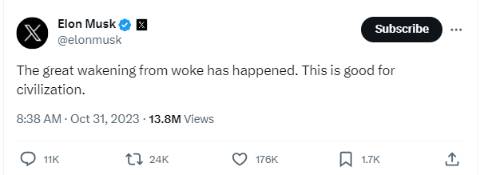
Notes:
Explain the context

Slide 3
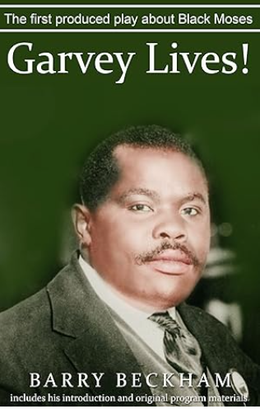
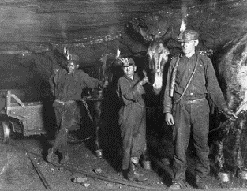
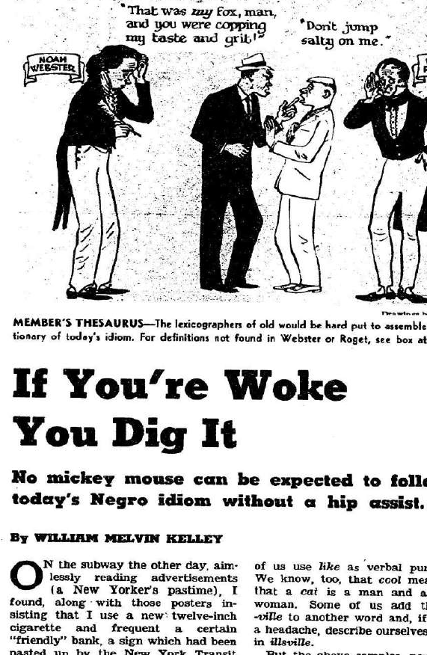
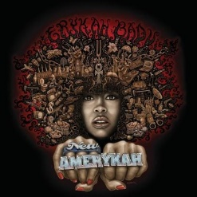
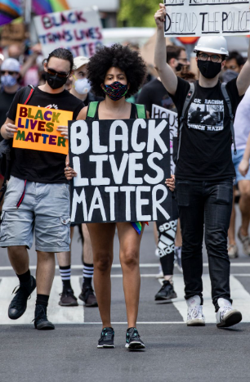
Woke… older than you think
1940
The Negro United Mine Workers launch a strike
in West Virginia against discriminatory pay. A
leader of the strike declares “we were asleep.
But we will stay woke from now on”.
1962
William Melvin Kelly’s essay ‘If You are Woke and You Dig It” appears in the New York Times.
1972
Author Barry Beckham uses “woke” in
his play Garvey Lives!
2008
Erykah Badu’s song “Master Teacher”
uses the lyrics “stay woke”.
2013
Black Lives Matter movement takes off in response to the acquittal of Trayvon Martin’s murderer, George Zimmerman.
2017
“Woke” gets added to the OED and Miriam Webster Dictionary with its new meaning of “being socially aware”.
Notes:
Explain the history

Slide 4
Woke… older than you think
1940
The Negro United Mine Workers launch a strike
in West Virginia against discriminatory pay. A
leader of the strike declares “we were asleep.
But we will stay woke from now on”.
1962
William Melvin Kelly’s essay ‘If You are Woke You Dig It” appears in the New York Times.
1972
Author Barry Beckham uses “woke” in
his play Garvey Lives!
2008
Erykah Badu’s song “Master Teacher”
uses the lyrics “stay woke”.
2013
Black Lives Matter movement takes off in response to the acquittal of Trayvon Martin’s murderer, George Zimmerman.
2017
“Woke” gets added to the OED and Miriam Webster Dictionary with its new meaning of “being socially aware”.
Notes:
Explain the history

Slide 5
Data & methods
Twitter (now X) between
1 January 2012 – 1 December 2022
All instances of #wokeasfuck and variants of it (Python code + Twitter API)
38,123 tweets
16,574 users
1,006,179 words
50 tweets/year = 550 tweets
357 users
12,237 words
WokeAF Twitter Corpus
WokeAF Sub-corpus

Slide 6

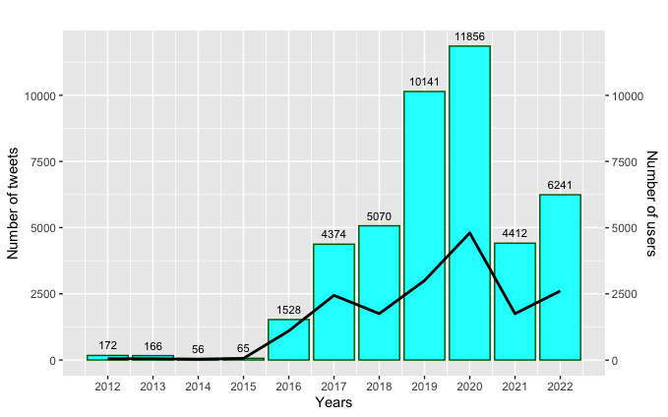
Notes:
Relates to the big corpus, all ~40K tweets

Slide 7
Meanings
Use | Description | Example
(1) Proper noun | Referencing either the WOKE AF Daily podcast with Danielle Moodie, the artist Snow Tha Product (including her song Snooze [Woke], her YouTube channel Woke TV and clothing line Woke Apparel), or an event (for example, the WOKE AF comedy show) | @XXX @SnowThaProduct haha she killed it brought it back to life then killed it AGAIN!! #WokeAF
(2) Criticising anti-woke | Critical of group being not 'woke' and unaware, or stuck in old principles | It's unconscionable that some people might not already know this. #wokeaf LINK
(3) Criticising woke culture | Critical of woke culture or views associated with it | #WokeAF #Democrats are offended over EVERYTHING. #ClownWorld 🤡 LINK
(4) Conspiracy theory | Hashtag is used alongside conspiracy-type messaging | Straight up mockery from those 2 knowing in reality they really are men. #flatearth #WokeAF #woke #AWAKE.. LINK
Notes:
Explain some of the meanings we found, with examples, they are subjective but together they show diversification of meaning and a shift away from a change of physical state to mental state of awareness and other related uses, political socio-culture context

Slide 8
Meanings
Use | Description | Example
(5) Spiritual awakening | Hashtag is used to describe spiritual awakening or to reference spirituality | Today Is A New Day, Let Go Of Your Past And Remember Any Paon Your Feeling Is Only Temporary, But Your Happiness Is ETERNAL♥️🔮😊 - #SnowBoy❄ #twitterlove #worldpeace #nopain #LetsGrowTogether #wokeaf
(6) ‘I’m aware’ | User positions themself as woke | Being #WokeAsFuck means that even in a room full of 'Black Consciousness', only a few of them will really SEE ME.
(7) Unable to sleep | Someone who is very much awake, wide awake | Look Like Ill Be Up All Night.. #WokeAF
(8) Clickbait | Hashtag is not relevant to tweet content but is used a clickbait to attract attention | Haven't posted in a bit. #NBA #sportsbets #bettingpicks #WokeAF LINK
Notes:
Explain some of the meanings we found, with examples, they are subjective but together they show diversification of meaning and a shift away from a change of physical state to mental state of awareness and other related uses, political socio-culture context

Slide 9
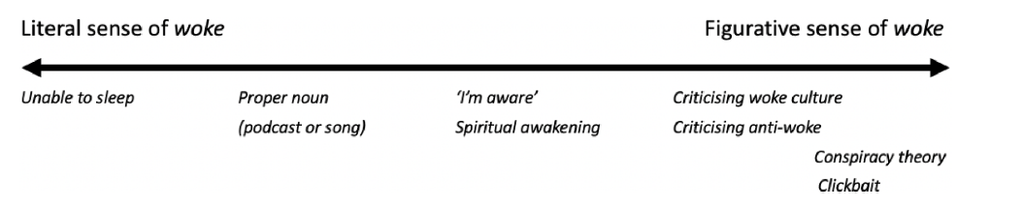
Meanings – summary
Notes:
Explain some of the meanings we found, with examples, they are subjective but together they show diversification of meaning and a shift away from a change of physical state to mental state of awareness and other related uses, political socio-culture context

Slide 10
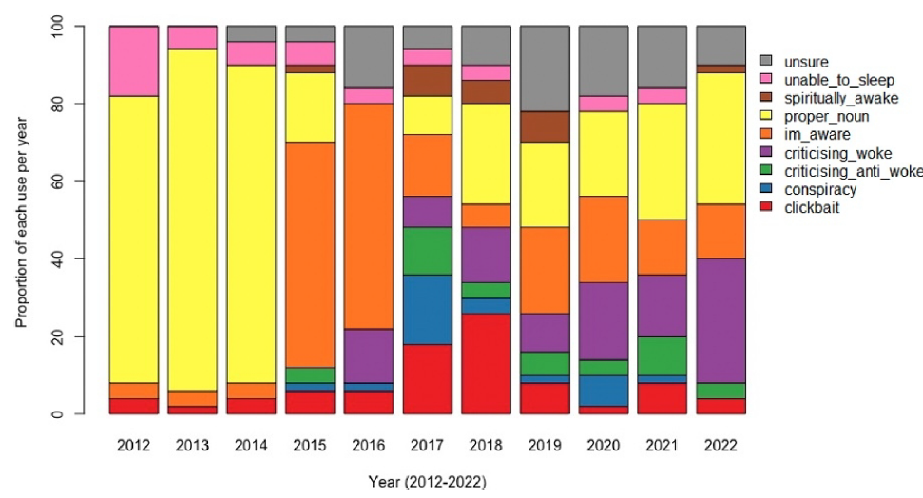
Distribution of meanings
Notes:
Proper noun uses are decreasing but still present, critical uses of woke are on the rise, i’m aware is still in there throughout with varying degrees

Slide 11
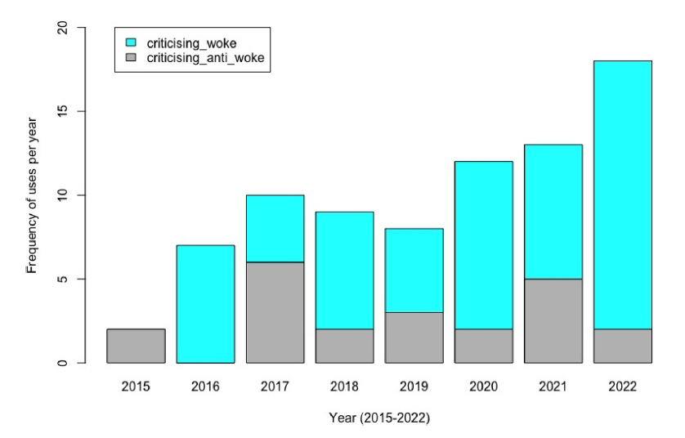
For or against the woke?
Notes:
Among those critical of woke culture, if we compare to those in favour or support of it (proud to be woke), the former is on the rise

Slide 12
Integrated in the syntax
(1) So this #independence thing is actually pretty #wokeaf. Just wish it wasnt treason...(October, 25, 2018)
(2) @XXX @XXX @XXX @FOX9 @XXX @MPRnews @StarTribune @PioneerPress But De-Russia is #WOKEAF! (June 8, 2022)
(3) @XXX @XXX @XXX Don’t waste your time with the #wokeaf. It’s unravelling. (November 29, 2022)
Notes:
Not all tweet-final uses are unintegrated, tag like instances.
Draw attention to example 3, where the noun (collective noun) use is detected. Discuss how we extracted all the + #woekaf uses from our large corpus in order to take a closer look at the function. We come back to this.

Slide 13
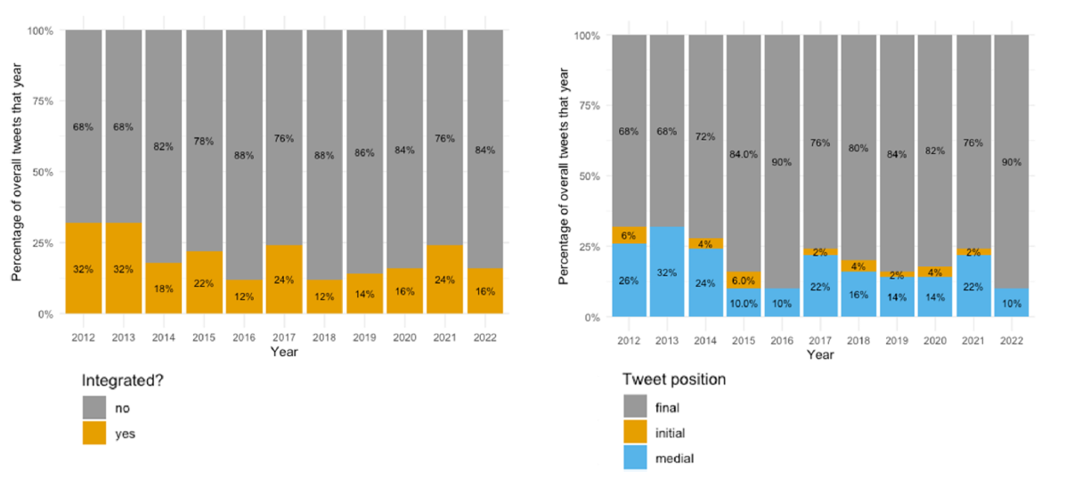
Structural matters
Notes:
First we focus on the integration of the hashtag and the position of it in the tweet. These are measures are associated, but as we said, not exclusively so, as some word-final hashtags are still integrated and some tweet-medial hashtags are not integrated, but these are in minority.

Slide 14
Changing grammatical uses
Verb (past tense woke)
New meaning (social awareness)
Adjective (woke movements, the woke agenda)
Woke + AF (adjective + as + expletive) → intensifying expletive construction
Good as gold
Cheap as chips
Free as a bird
Clear as day
Safe as houses
Mean as
Cool as
Sweet as
Cheap as
Dumb as
as-similes
as-intensifier (booster)

Slide 15
Changing grammatical uses
Verb (past tense woke)
New meaning (social awareness)
Adjective (woke movements, the woke agenda)
Woke + AF (adjective + as + expletive) → intensifying expletive construction
Collective noun (here come the #wokeaf)

Slide 16
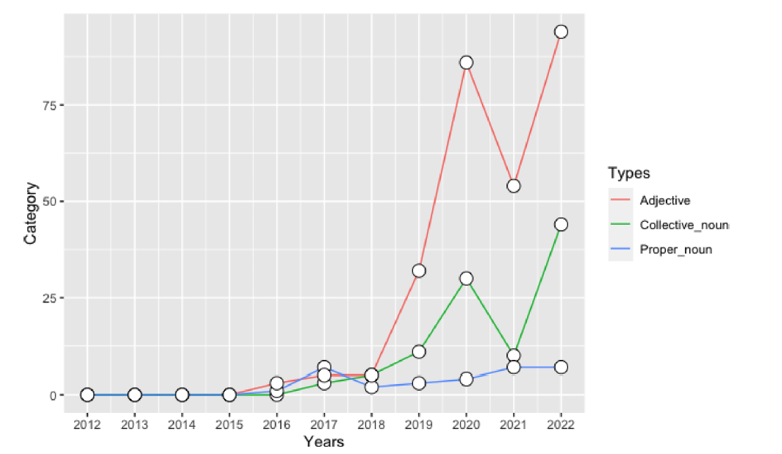
The + #wokeaf
Notes:
In general collective noun uses are increasing, and there is a twist.

Slide 17
Collective noun uses
(4) @XXX @XXX @timescolonist Correct XXX, I have no reason to think that there will be any improvement, in fact it could be worst now that the #wokeaf have a solid majority on @CityofVictoria council. (October 31, 2021)
(5) @XXX @XXX @XXX. That’s all a made up narrative used by the #wokeaf . #Gaslighter (October 10, 2022)
(6) @MyMind_MyChoice Langford used to be the sweet spot until the #wokeaf effed it up (October 22, 2022)

Slide 18
Discussion
Analysing (even) single words/phrases (hashtags) can capture changes in ideology and norms.
Intensifiers, slang and expletives constitute rich sources for innovation, not just lexical but also grammatical.
Social media is a hot-bed of viral activity which can propel these changes.

Slide 19
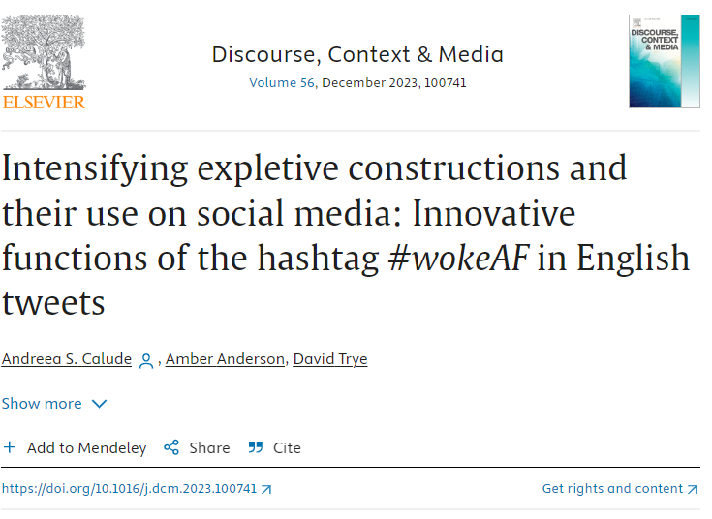

Ngā mihi
University of Waikato Summer Scholarship
University of Waikato Doctoral Scholarship
https://authors.elsevier.com/c/1hzQ17suQFuPIa

